Slide 1

North American Computational Linguistics Olympiad
n
a
c
l
o
Lori Levin
Language Technologies Institute
Carnegie Mellon University

Slide 2
Web sites
North American Computational Linguistics Olympiad
  http://www.naclo.cs.cmu.edu
International Linguistics Olympiad
  http://www.ioling.org
Videos about NACLO on You Tube
  http://www.youtube.com/watch?v=82rbhy4Xjbs
  http://youtu.be/ao2tX3_qakU

Slide 3


International Linguistics Olympiad
http://www.ioling.org

Slide 4
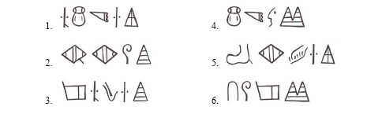
Fascinating, addictive language puzzles
Tajik
Luvian
Swahili

Slide 5
Linguistics and NACLO
Languages have structure that you can discover.

Slide 6
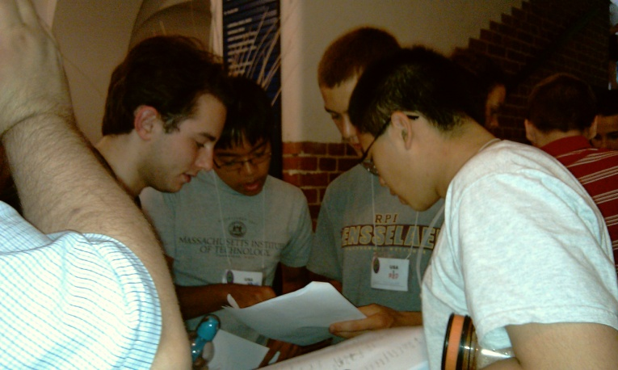
NACLO: what?
A nation-wide pencil and paper contest with no pre-requisites.
  Free too!
Problems about human language and computation.
  Easy problems:
    everyone has a good time and learns something about human language and/or computation
  Hard problems:
    identify the students who are most skilled at seeing patterns and structure
    assemble a team that can win an international competition

Slide 7
NACLO: when and where
Open competition
  January 31, 2013
Invitational competition
  Mid March
You can participate at your school or at a university host site.

Slide 8
NACLO: Who
Any student who is not in college yet
Mostly high school
Some middle school
Winners have been 13 to 18 years old

Slide 9
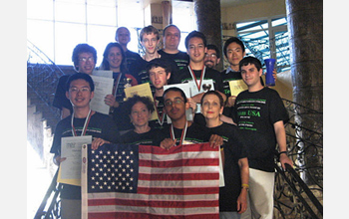
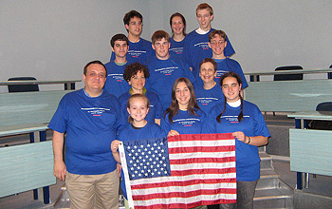
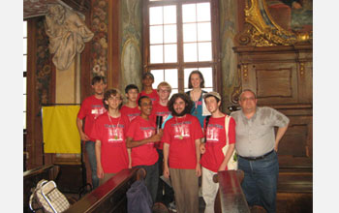
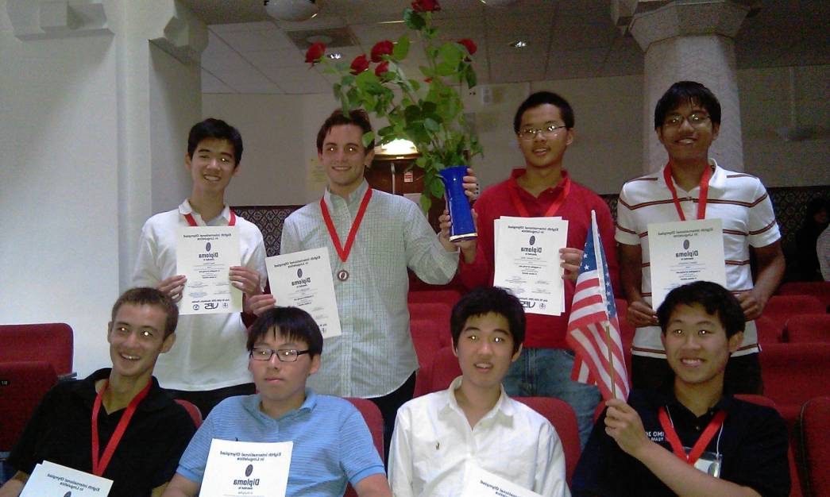
IOL International Linguistics Olympiad
http://www.ioling.org

Slide 10
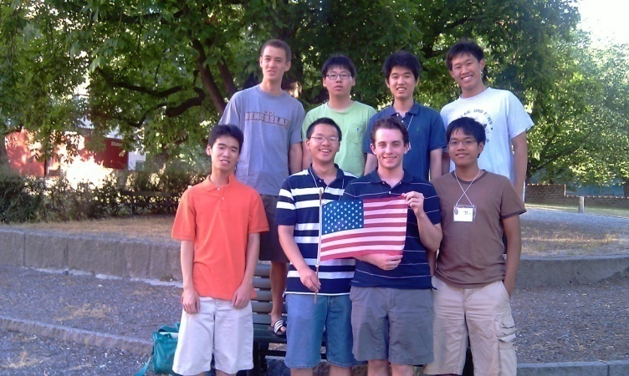
NACLO and IOL
The top eight students in the invitational competition are invited to the International Linguistics Olympiad (IOL).
  IOL is in the UK in 2013
IOL has individual and team competition (teams of four).
Each country may send two teams.
  Around 30 countries participate
The US has participated in six IOLs.
Canada has participated in two IOLs.

Slide 11
What is Linguistics?
The study of human language
  As opposed to the study of human languages
How long ago did humans start talking?
How many languages are there?
What is grammar?
How are they different from English?

Slide 12
Questions that Linguists ask
What parts of the brain are used for producing and comprehending language?
How do languages change?
Why do languages change?
How does language correlate with social factors?
  E.g., Jocks and Burnouts (Eckert)
What do human languages have in common?
How are human languages different from animal communication?
How is it that a baby can learn his/her first language perfectly, but an adult cannot learn a second language perfectly?

Slide 13
Why linguistics?
Human language is central to human communication and social interaction.
Human language is a property of the human mind.
You can practice discovering patterns and structure.
You can practice scientific reasoning (forming hypotheses and knowing which data support them).

Slide 14
Language Technologies
Computational Linguistics
Natural Language Processing

Slide 15
What is NLP?
“Natural language processing is the technology for dealing with our most ubiquitous product: human language…”
  Chris Manning and Dan Jurafsky: http://www.nlp-class.org/
  “ubiquitious” means it’s everywhere

Slide 16
We produce language to talk to
Machines
  Search queries
  Siri
  Telephone dialogue systems
Each other
  “human language …. in emails, web pages, tweets, product descriptions, newspaper stories, social media, and scientific articles, in thousands of languages and varieties.”
    Chris Manning and Dan Jurafsky: http://www.nlp-class.org/
Each other mediated by a machine that translates

Slide 17
You use Natural Language Processing every day
Search queries
Spell check
Grammar check
Spam detection
Telephone dialogue systems
Siri and similar things
Google pops up ads that are related to the email you are typing.

Slide 18
But what IS NLP?

Slide 19
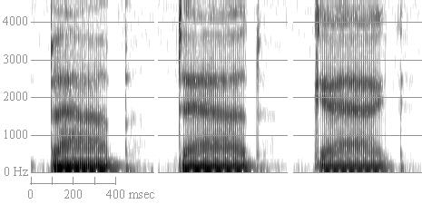
bab, dad, gag
What frequencies are present in sound waves when you speak?

Slide 20
Where are the words?
世界人权宣言
联合国大会一九四八年十二月十日第217A(III)号决议通过并颁布
1948 年 12 月 10 日， 联 合 国 大 会 通 过 并 颁 布《 世 界 人 权 宣 言》。 这 一 具 有 历 史 意 义 的《 宣 言》 颁 布 后， 大 会 要 求 所 有 会 员 国 广 为 宣 传， 并 且“ 不 分 国 家 或 领 土 的 政 治 地 位 , 主 要 在 各 级 学 校 和 其 他 教 育 机 构 加 以 传 播、 展 示、 阅 读 和 阐 述。” 《 宣 言 》 全 文 如 下：
序 言
OnDecember10,1948theGeneralAssemblyoftheUnitedNationsadoptedandproclaimedtheUniversalDeclarationofHumanRightsthefulltextofwhichappearsinthefollowingpages.FollowingthishistoricacttheAssemblycalleduponallMembercountriestopublicizethetextoftheDeclarationandtocauseittobedisseminated,displayed,readandexpoundedprincipallyinschoolsandothereducationalinstitutions,withoutdistinctionbasedonthepoliticalstatusofcountriesorterritories.

Slide 21
Where are the words?
theyouthevent

Slide 22
Where are the words?
There are no spaces in spoken language, so every spoken language is like Chinese writing:
  How to recognize speech
  How to wreck a nice beach
  How to wreck an ice peach

Slide 23
Where are the morphemes?
İnsan hakları evrensel beyannamesi
Önsöz
İnsanlık ailesinin bütün üyelerinde bulunan haysiyetin ve bunların eşit ve devir kabul etmez haklarının tanınması hususunun, hürriyetin, adaletin ve dünya barışının temeli olmasına,
İnsan haklarının tanınmaması ve hor görülmesinin insanlık vicdanını isyana sevkeden vahşiliklere sebep olmuş bulunmasına, dehşetten ve yoksulluktan kurtulmuş insanların, içinde söz ve inanma hürriyetlerine sahip olacakları bir dünyanın kurulması en yüksek amaçları oralak ilan edilmiş bulunmasına,
On December 10, 1948 theGeneralAssembly of theUnitedNations adopted and proclaimed theUniversalDeclaration of HumanRights thefulltext of which appears in thefollowingpages. Following thishistoricact theAssembly called upon allMembercountries topublicize the text of theDeclaration and to cause it tobedisseminated, displayed, read and expounded principally in schools and other educationalinstitutions, without distinction based on thepoliticalstatus of countries or territories.

Slide 24
Which words are these?
n dcmbr 10, 1948 th gnrl ssmbly f th ntd ntns dptd nd prclmd th nvrsl dclrtn f hmn rghts th fll txt f whch pprs n th fllwng pgs. fllwng ths hstrc ct th ssmbly clld pn ll mmbr cntrs t pblcz th txt f th dclrtn nd t cs t t b dssmntd, dsplyd, rd nd xpndd prncplly n schls nd thr dctnl nstttns, wtht dstnctn bsd n th pltcl stts f cntrs r trrtrs.

Slide 25
Ambiguity in English
IRAQI HEAD SEEKS ARMS
KIDS MAKE NUTRITIOUS SNACKS
BRITISH LEFT WAFFLES ON FALKLAND ISLANDS
STOLEN PAINTING FOUND BY TREE

Slide 26
Careers
Humanitarian
Industry
Government
Academic
Education

Slide 27
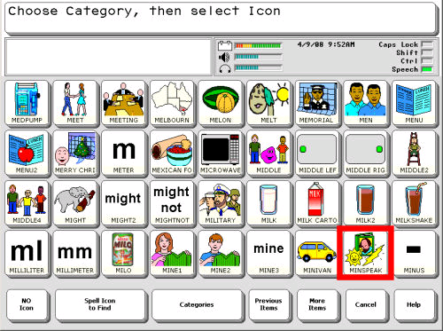
Careers
Humanitarian
Machine translation for disaster relief and humanitarian aid.
Translate between aid workers and victims of disease or natural disaster.
Technologies such as spelling checkers to help revitalize endangered languages
Assistive technologies for people with disabilities

Slide 28
Careers
Search engines
Natural language voice interfaces
Talking to machines
Summarization
because there is more information than people can attend to
Sentiment detection
Did people like the product or movie?
Machine Translation
Translate from one language to another
Industry
Facebook
Twitter
Google
Yahoo
Reuters
General Motors
Microsoft
Amazon

Slide 29
Careers
National Security:
There is more information than human analysts can attend to.
Machine Translation
Speech recognition
Summarization and information extraction
Detection of sentiment and deception
Government

Slide 30
Careers
Computer Assisted Language Learning
Automatically detect errors
Automated grading of essays
Educational Testing Service
Analysis of educational dialogue
The way you interact affects the way you learn
Education

Slide 31
Careers
Work at a university
Train the next generation
Do research on unsolved problems in Natural Language Processing
Academic

